Slide 1
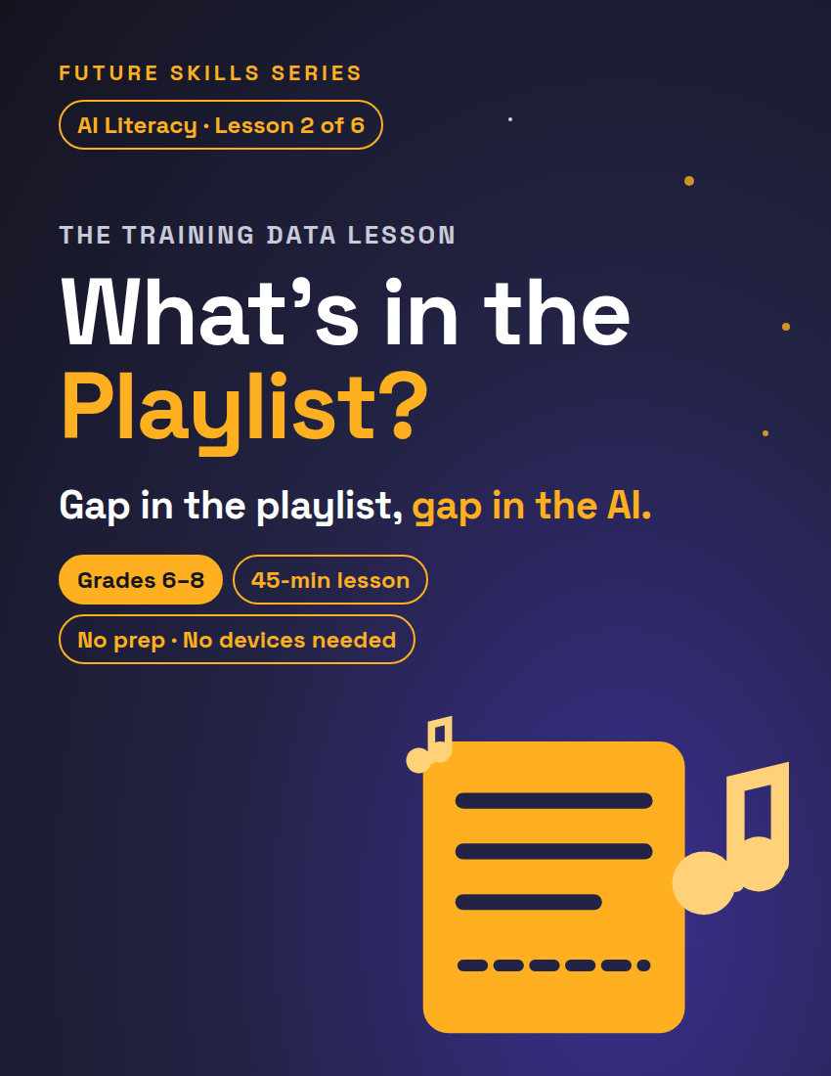
FUTURE SKILLS · AI LITERACY
THE TRAINING DATA LESSON
What's in the Playlist?
An AI is a music app, and its training data is the playlist. It can only mix what's in the playlist — so today you'll BE the app and find out what a one-vibe playlist (all loud, all fast, all party) does to everyone who asks.
Grades 6–8
45-min lesson
No prep · No devices needed
1 / 12
Notes:
Open on this slide while students settle. Worksheet: Playlist Check, one per student — each student fills their OWN sheet. Fully unplugged — no devices needed.

Slide 2
FUTURE SKILLS · AI LITERACY
7 MIN
Warm-Up — The One-Playlist App
I am AutoMix, the school's new music app. One playlist. Who's got a request?
"Something chill to study to?" → "Here's 'TURBO TURBO.' It is not chill. It's what I've got."
"A song for grandma's birthday dinner?" → "Got it. 'VOLUME WAR.' Grandma loves bass drops, probably."
"A slow song for the last dance?" → "'NEON STAMPEDE,' played at... the exact same speed."
2 / 12
Notes:
You are AutoMix. Your playlist holds one kind of song: loud, fast party tracks. Take 3–4 requests and serve every one with total confidence — never apologize, announce the track like it's exactly right, upgrade nothing. Keep it to 3–4 so the joke lands and moves.

Slide 3
FUTURE SKILLS · AI LITERACY
Something's broken. What?
?
Is AutoMix bad at picking songs — or is something else broken?
3 / 12
Notes:
ANSWER (not on the slide): the app is doing its job perfectly — the PLAYLIST is the problem. Fish for it. When a student says it, hand them the imaginary aux cord — they just said the thesis of the lesson. What if nobody gets there? Ask: "If I handed AutoMix one slow song, could it play it?" Yes — so the app works. What's missing? Bridge: "If you did the genie lesson: it granted what you SAID. If you didn't, no problem — today stands alone. Today: where an AI's answers even come from. Everything an AI 'knows' comes from a playlist of examples — its training data. It can remix the playlist, but it can't serve what was never in it. Today you'll BE the app."

Slide 4
FUTURE SKILLS · AI LITERACY
8 MIN
No Magic in the Machine
1
2
3
INPUT
PATTERNS
OUTPUT
The playlist. Training data: the giant pile of examples an AI studies before you ever meet it. Nobody types "knowledge" in.
The training. It works through the playlist and gets good at ONE thing: guessing what usually goes with what. No understanding — patterns.
The mix. Ask for something and it predicts what best matches its playlist's patterns. A prediction, not a lookup — confident and still off.
4 / 12
Notes:
Write the chain on the board as you go: INPUT → PATTERNS → OUTPUT. Songs for a music app, mountains of human writing for a chatbot — same chain. The AI doesn't understand any of it; it finds patterns.

Slide 5
FUTURE SKILLS · AI LITERACY
“
No magic in the machine. An AI doesn't KNOW things — it predicts things.
Two rules run everything: a GAP in the playlist is a gap in the AI, and a LEAN in the playlist leans every answer. That lean has a name: bias.
5 / 12
Notes:
Say it plainly: "No magic in the machine. An AI doesn't KNOW things — it predicts things, from its playlist. So two rules run everything: a GAP in the playlist is a gap in the AI, and a LEAN in the playlist leans every answer. That lean has a name: bias."

Slide 6
FUTURE SKILLS · AI LITERACY
Quick check
?
A photo AI's playlist is almost all golden retrievers. A husky walks in — what's it going to call it?
6 / 12
Notes:
ANSWER (not on the slide): golden retriever — its best guess from its patterns. Gap in, gap out. What if a student says "husky"? "Has this AI ever seen one? It can only pick from the patterns it has." Transition: "Hand out Playlist Check; pairs up." Point to the grey box at the top of page 1: Partner A is the App, Partner B is the Caller.

Slide 7
FUTURE SKILLS · AI LITERACY
20 MIN
Activity — Playlist Check
1
Setup · 3 min
Pairs. Partner A = the App. Partner B = the Caller. The 12 cards are your playlist.
2
Serve the Caller · 9 min
Six requests. App names the card; both write it and check one Fit box. Swap after #3.
3
Playlist Gap Report · 5 min
Who does the playlist serve well? Who does it leave out? Repeat your partner, then add.
4
Fix the Playlist · 3 min
Invent new cards for the biggest gaps — at least 2. Which request still has nothing?
7 / 12
Notes:
Setup: the 12 song cards ARE the app's training data — cut them apart or just point. Odd number? A trio: two Callers, one App, swap twice. Serve: work the six printed requests (Priya, Nia, Tomás, Keisha, Malik, Jordan); end with one live request from a neighboring pair. Can't agree on a Fit? Each writes their own mark — disagreement is data; save it for the debrief. Gap Report: enforce the rule out loud — before you add your idea, repeat your partner's, then add to it. A pair writes "needs more songs"? Ask WHO asked for something that wasn't there. Fix: push past "add one slow song" — Tomás still has nothing. KEY: Tomás, Keisha and Jordan are the built-in failures — zero Spanish, nothing slow, nothing quiet.

Slide 8
FUTURE SKILLS · AI LITERACY
House Rules — You Are the AI
Rule 1 — You can ONLY serve cards from the playlist. No inventing songs mid-game.
Rule 2 — You never say no. Serve the closest card you've got — a music app always gives you SOMETHING.
Rule 3 — Check ONE Fit box (Perfect / Kind of / Nothing) honestly, on your own sheet.
Fit boxes: Perfect fit · Kind of fits · Nothing fits — check ONE per request.
8 / 12
Notes:
Leave this up during Serve the Caller. Circulate. Answer key is in the Teacher Guide p.1 — Priya and Malik should be Perfect fit; Nia Kind of fits at best (Cool Down is medium, still a party track); Tomás, Keisha and Jordan Nothing fits.

Slide 9
FUTURE SKILLS · AI LITERACY
5 MIN
Debrief — The Real Playlists
YOUR PLAYLIST
REAL PLAYLISTS
Who asked for Spanish and got English?
Who asked for slow and got medium?
Who asked for quiet and got nothing quiet?
Voice assistants have misheard rare accents and kids more often.
Photo tools got darker skin wrong more; most photos were light.
Your feed learned from millions of users.
9 / 12
Notes:
2–3 pairs call out one gap they found (1 min). Left panel is questions only — the answers, for you: Tomás (zero Spanish tracks), Keisha (medium is not slow), Jordan (nothing quiet exists). Nobody put bad songs in; they were never there. Connect: "Your playlist failed Tomás and Keisha. Real playlists fail real people the same way." Walk the three real playlists (Teacher Guide p.2, 3 min): voice assistants understand best the voices that filled their training audio; face-analysis tools have had higher error rates on darker skin when training photos leaned lighter (documented in 2018 research); a recommendation app's playlist is millions of people's viewing behavior — your own history is the request. Handle with care: some students in the room are the people these gaps mishear. Keep the frame "the playlist failed them, and playlists can be fixed" — never "the tech doesn't like you."

Slide 10
FUTURE SKILLS · AI LITERACY
The big question
?
Nobody put bad songs in your playlist — so where did the bias come from?
10 / 12
Notes:
ANSWER (not on the slide): from what got collected — and what didn't (1 min). "Did someone do this on purpose?" Usually not — teams collect the data that's easiest to get, and easy data leans toward whoever is already over-represented. No villain required — which is why good AI teams audit their playlists before shipping. If asked "isn't AI creative, though?": it can mash up playlist patterns into new combos, but it can't mash up a genre it has never heard.

Slide 11
FUTURE SKILLS · AI LITERACY
5 MIN
Exit Ticket
1. Finish the chain: INPUT → ______ → OUTPUT. In your own words, what does an AI do with its playlist?
2. A homework-helper AI only knows football examples. Use "playlist": what happened, and who does it fail?
3. One gap your partner spotted before you did — in your own words.
11 / 12
Notes:
Bottom of worksheet p.2. Collect; exemplars are in the Teacher Guide p.2. KEY #1: PATTERNS — the AI studies its playlist, learns what usually goes with what, and predicts. Assesses ISTE 1.1.d. KEY #2: whoever filled its playlist used football examples, so football patterns are all it can serve; students whose interests never made the playlist get worse help. Assesses CSTA 2-IC-21 — look for WHO gets worse help, not just "needs more songs." KEY #3: any real gap in the student's own words that names a person or a request; not "more songs." Assesses SL.6.1 (building on a partner's idea).

Slide 12
FUTURE SKILLS · AI LITERACY
Before you trust an AI, ask: what's in the playlist?
You → the AI's playlist → you. A human starts it, the AI does the middle, a human checks — and playlists can be fixed.
12 / 12
Notes:
Close on this: the playlist is the middle of human → AI → human, and a gap in it is why the human at the end has to check. Next in the unit: Hallucination Hunters (Lesson 3 — in the unit bundle, or sold separately) — fact-checking what an AI hands you. This lesson stands on its own.

